Slide 1
Providing Value Added Service
To Halal Certification
Your Guide to the Global Halal Market ™
Timothy Abu Mounir Hyatt
Managing Director
thyatt@isahalal.com

Slide 2
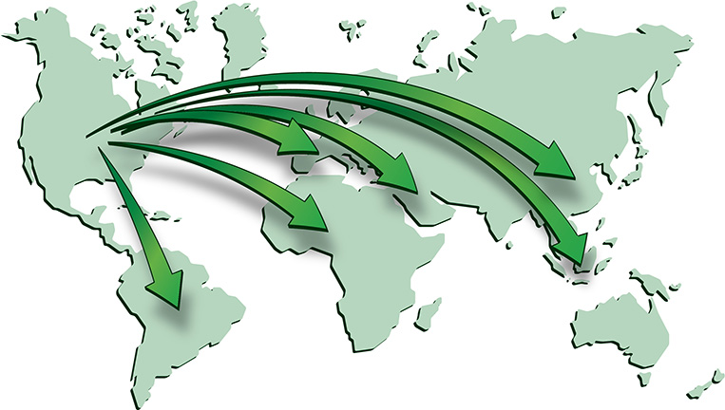
The Importance and Value of Halal Certification Continues to Grow in the USA and Globally

Slide 3
How HCBs Educate Clients and Promote the Concept of Halal to Reach Their Desire to Add Revenue and Growth
Introduce and define the concept of Halal from both religious and technical perspectives.
Explain how manufacturers, distributors and end users benefit from Halal certified products.
Discuss opportunities for Halal product sales beyond one’s own borders.
Meet Halal export certificate documentation needs.
3
©2020 Islamic Services of America (“ISA”); Confidential and Proprietary to ISA, not to be shared or disseminated without the prior written permission of ISA

Slide 4
Demonstrate Halal Credentials, Accreditations and Affiliations
As a member of the World Halal Food Council (WHFC), ISA upholds international Halal assurance standards for all global markets and including the key SE Asia region: Malaysia (JAKIM), Indonesia (MUI), Singapore (MUIS) and The Philippines (IDCCP).
We have many respectful mutual recognition relationships with credible well established
global Halal certifiers from Australia to Pakistan, and Brazil to the UK, South Africa to Vietnam and everywhere in between.
4

Slide 5
Is Halal Certification Just a Business?
5

Slide 6
Is it a Religious Obligation?

Slide 7
Is it Both?
7

Slide 8
Is it Dawah?
8

Slide 9
Halal Certification is All of These
A Religious Obligation
A Business
A Dawah Opportunity
9

Slide 10
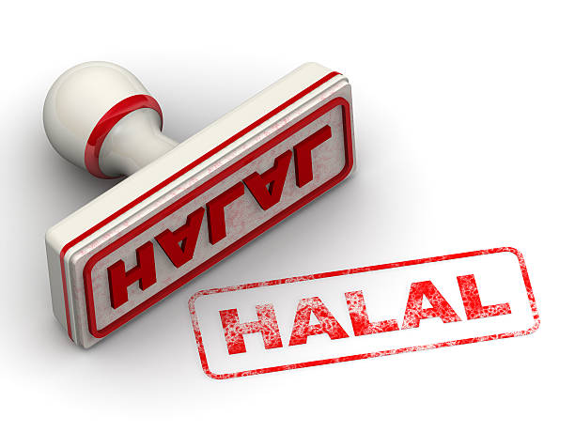
Why is Halal Important and to Whom? Why is it important for local and overseas markets?
The Growth and Importance
of Halal Certification Globally
10

Slide 11
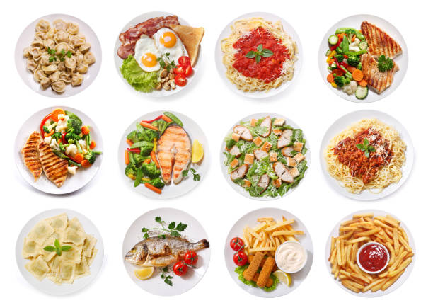
The Growth and Importance
of Halal Certification Globally
It’s a way of life for Muslim
Consumers
It’s an important marketability strategy for manufacturers and product brand owners
11

Slide 12
Why Do Product Manufacturers Need or Want Halal Certification?
Are they seeking Halal certification because their customers are asking for it or for their own purposes to add to their other certification credentials?
To understand the scope of a client’s needs, ask big picture questions, understand their role in the supply chain industry or how far they want their own proprietary product brands to reach.

Slide 13
Why Do Product Manufacturers Need or Want Halal Certification?
Does the client’s entire organization from sales, marketing, operations, quality assurance, legal and regulatory understand the product selling points and the intended markets (buyers, further processors, importing countries, consumers, etc.)?
Provide them with global statistics and insight into the minds of Muslim consumers worldwide. Share our own cultural and ethnic experiences.

Slide 14
How do HCBs Educate Clients and Promote the Concept of Halal to Reach Their Desire to Add Revenue and Growth
Introduce and define the concept of Halal from both religious and technical perspectives.
Explain how manufacturers, distributors and end users benefit from Halal certified products.
Discuss opportunities for Halal product sales beyond one’s own borders.
Discuss Halal export certificate documentation needs.

Slide 15
Convey the Religious Basis and Rationale of Halal Requirements
Halal integrity requires the same stringent steps and documentation trails as many other certification programs.
However, Halal has a religious element that other certifications don’t include besides the Kosher industry.
Halal certifiers may provide religious origins and background principles of what Halal means. This is where Dawah naturally becomes part of the process.

Slide 16
Convey the Religious Basis and Rationale of Halal Requirements
Conveying the basis of religious Halal requirements is especially important in Western cultures that are largely unfamiliar with Islam. Most Westerners only know what hear and see in the news and social media. Many have never met or had a simple conversation with Muslims.
Halal certification personnel understand this from direct experience. Many of us have visited, studied, worked, lived or grown up in both Muslim majority and Muslim minority countries.
We are the ambassadors of Halal!

Slide 17
How Can an HCB Demonstrate and Provide Value Added Services?
Be well organized and staffed with polite, professional, proficient, attentive, responsive and knowledgeable personnel.
Clearly and succinctly explain technical Halal compliance and the requisite steps to receiving Halal certification.
Refer technical and religious based questions to the Halal QA team, Shariah team and management staff to clarify international Halal standards and religious concepts for greater comprehension.

Slide 18
How Can an HCB Demonstrate and Provide Value Added Services?
Serve the customer in a timely manner to create and foster respect and a strong relationship with key customer contacts and at all levels of their organization. Response turnaround time counts!
Explain Halal Compliance and Halal Assurance Systems and ensure they are in place during annual and interim facility and documentation audit reviews and through ongoing communication.

Slide 19
Anticipate and Answer
the Unasked Questions
Follow up with written summaries and bullet point action items by email for documentation records on both sides and for future follow up.
Use topic headers to highlight discussion categories - bold, underline and number them for easy reading.
Add points not covered on the call for future consideration.

Slide 20
Anticipate and Answer
the Unasked Questions
Follow up with written summaries and bullet point action items by email for documentation records on both sides and for future follow up.
Use topic headers to highlight discussion categories - bold, underline and number them for easy reading.
Add points not covered on the call for future consideration.

Slide 21
Provide Ongoing Support
Changes in the industry can happen quickly and often.
Leading Halal certifiers are at the head of the pack when manufacturing industry developments and innovation require new rulings.
This information is shared with the client base through HCB website blogs and direct contact with key client contacts.

Slide 22
Provide Ongoing Support
Maintain a strong rapport with client personnel at all decision maker and hands on production levels.
Understand client products and global markets. Speak to those unique factors when Halal industry changes come about.
Provide Halal orientation to new client staff contacts when they come on board

Slide 23
Halal Certification as a Means of Dawah
So while we educate our customers, buyers, consumers and the general public, at the same time we also put our best face forward as Muslims. As such, our positive and professional behaviors are appreciated and well noted.
Is this not Dawah?

Slide 24
Halal Certification as a Means of Dawah
We explain that the term Halal is a critical element of a Muslim’s life as prescribed in the Qur’an and Hadeeth. Much of it is “Biblical” and what was taught, followed and practiced by the Ahl Kitab was according to Allah’s will.
Therefore what we follow is nothing new or novel. We simply continue to follow what was prescribed and reinforced to us on a regular daily consistent basis.

Slide 25
Halal Certification as a Means of Dawah
The idea of behaving and consuming foods in a manner which is permissible is a sensible, logical and spiritual and practical way of life.
Living a Halal lifestyle is healthy and safe for one’s own taqwa and self-preservation!
Bringing the “Islam” of Muslim staff to the forefront and giving an overview of Halal and Islam to those who have some or no understanding is an enormous act of Dawah. It should be our personal vision, mission and commitment
25

Slide 26
Halal Certification as a Value Added Service
As a Muslim service industry serving manufacturers, product brand owners and Halal consumers it is our duty to be full-service providers.
It is our role to be professional.
It is our obligation to represent Islam in the positive manner that we know it to be.
26

Slide 27
Halal Certification as a Value Added Service
It is an expectation that we abide by Islamic principals for our clients and of course to our ummah.
Blending these best practices will leave others with the best impression of what value-added service is through respectful behaviors that create lasting relationships.
27

Slide 28
Halal is a Way of Life!
Halal certification is a measure of confidence for all consumers. Certifiers are held to that purpose.
www.isahalal.com
isa@isahalal.com
Tel: (319) 362-0480
ISA is Your Guide to the Global Halal Market

